Slide 1


EXECUTIVE PRESENTATION • TECHNICAL DELIVERY MANAGEMENT
TDM Nexus: AI-Driven Portfolio Delivery
Transforming Technical Delivery Oversight into Predictive Steering & Measurable ROI.
The Executive Friction: According to PMI, project leaders spend up to 54% of their working hours on manual status updates and tracking. While many deploy generic AI, McKinsey research confirms that up to 300% ROI is realized only when AI is embedded directly into core delivery governance.

Slide 2




The Strategic Shift: Reactive vs Predictive
Traditional Delivery Governance
TDM Nexus AI Paradigm
→
54% Admin Waste: PMs spend half their time collecting manual updates across tools.
→
Automated Synthesis: Real-time delivery data transformed into executive updates instantly.
→
Late Risk Detection: Technical blockers are discovered only during milestone failures.
→
Predictive Risk Engine: Early alerts flag delivery velocity drops before deadline slips.
→
Fragmented Visibility: Cross-project dependency collisions remain hidden in siloes.
→
Unified Governance: Centralized technical delivery nerve center for portfolio leaders.
→
Disconnected AI: Standalone chatbots offer generic summaries without operational context.
→
Embedded ROI: Up to 3x productivity gains built directly into team workflows.

Slide 3


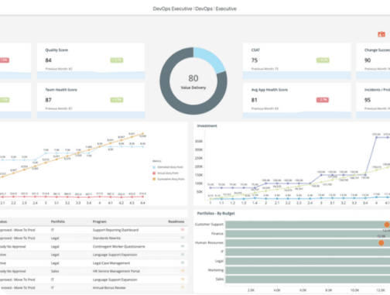
TDM Nexus Feature Spotlight
Centralized Delivery Hub
Aggregates technical metrics, tickets, and release pipelines into a unified executive dashboard.
AI Risk & Blocker Engine
Automatically flags dependency bottlenecks, resource burn spikes, and potential milestone delays.
1-Click Executive Briefings
Generates tailored, concise narrative summaries for senior portfolio managers in seconds.

Slide 4



Measurable Portfolio Impact
54%
300%
72%
Time Recovered
Targeted ROI
Risk Avoidance
Reduction in manual status collection and deck compilation for project leads.
Achieved by embedding AI natively into delivery governance workflows.
Proactive mitigation of cross-project dependency collisions before milestone breach.

Slide 5








Portfolio Rollout Strategy
Phase 1: Pilot
Phase 2: Integrate
Phase 3: AI Tuning
Phase 4: Scale
Onboard 2 key technical delivery streams into TDM Nexus hub.
Connect CI/CD pipelines, issue trackers, and automated telemetry.
Configure custom risk thresholds and automated executive reporting.
Expand across full portfolio with standardized governance dashboards.

Slide 6

Image Sources
https://digital.ai/wp-content/uploads/2022/09/RC-SS-AI-2023-4-intelligence-product-screenshot.png
Source: digital.ai

